Slide 1
Welcome to Bio212L Section 2!
As you come in today:
Get your lab coat on & buttoned!
Wash your hands and wipe down your bench
Turn on your incinerator
Write down:
the biochemical assay (thurs or tues) you’re most confused by
What you’re going to do on your snow day
..on your whiteboard
Notes:
Open clock app!!

Slide 2
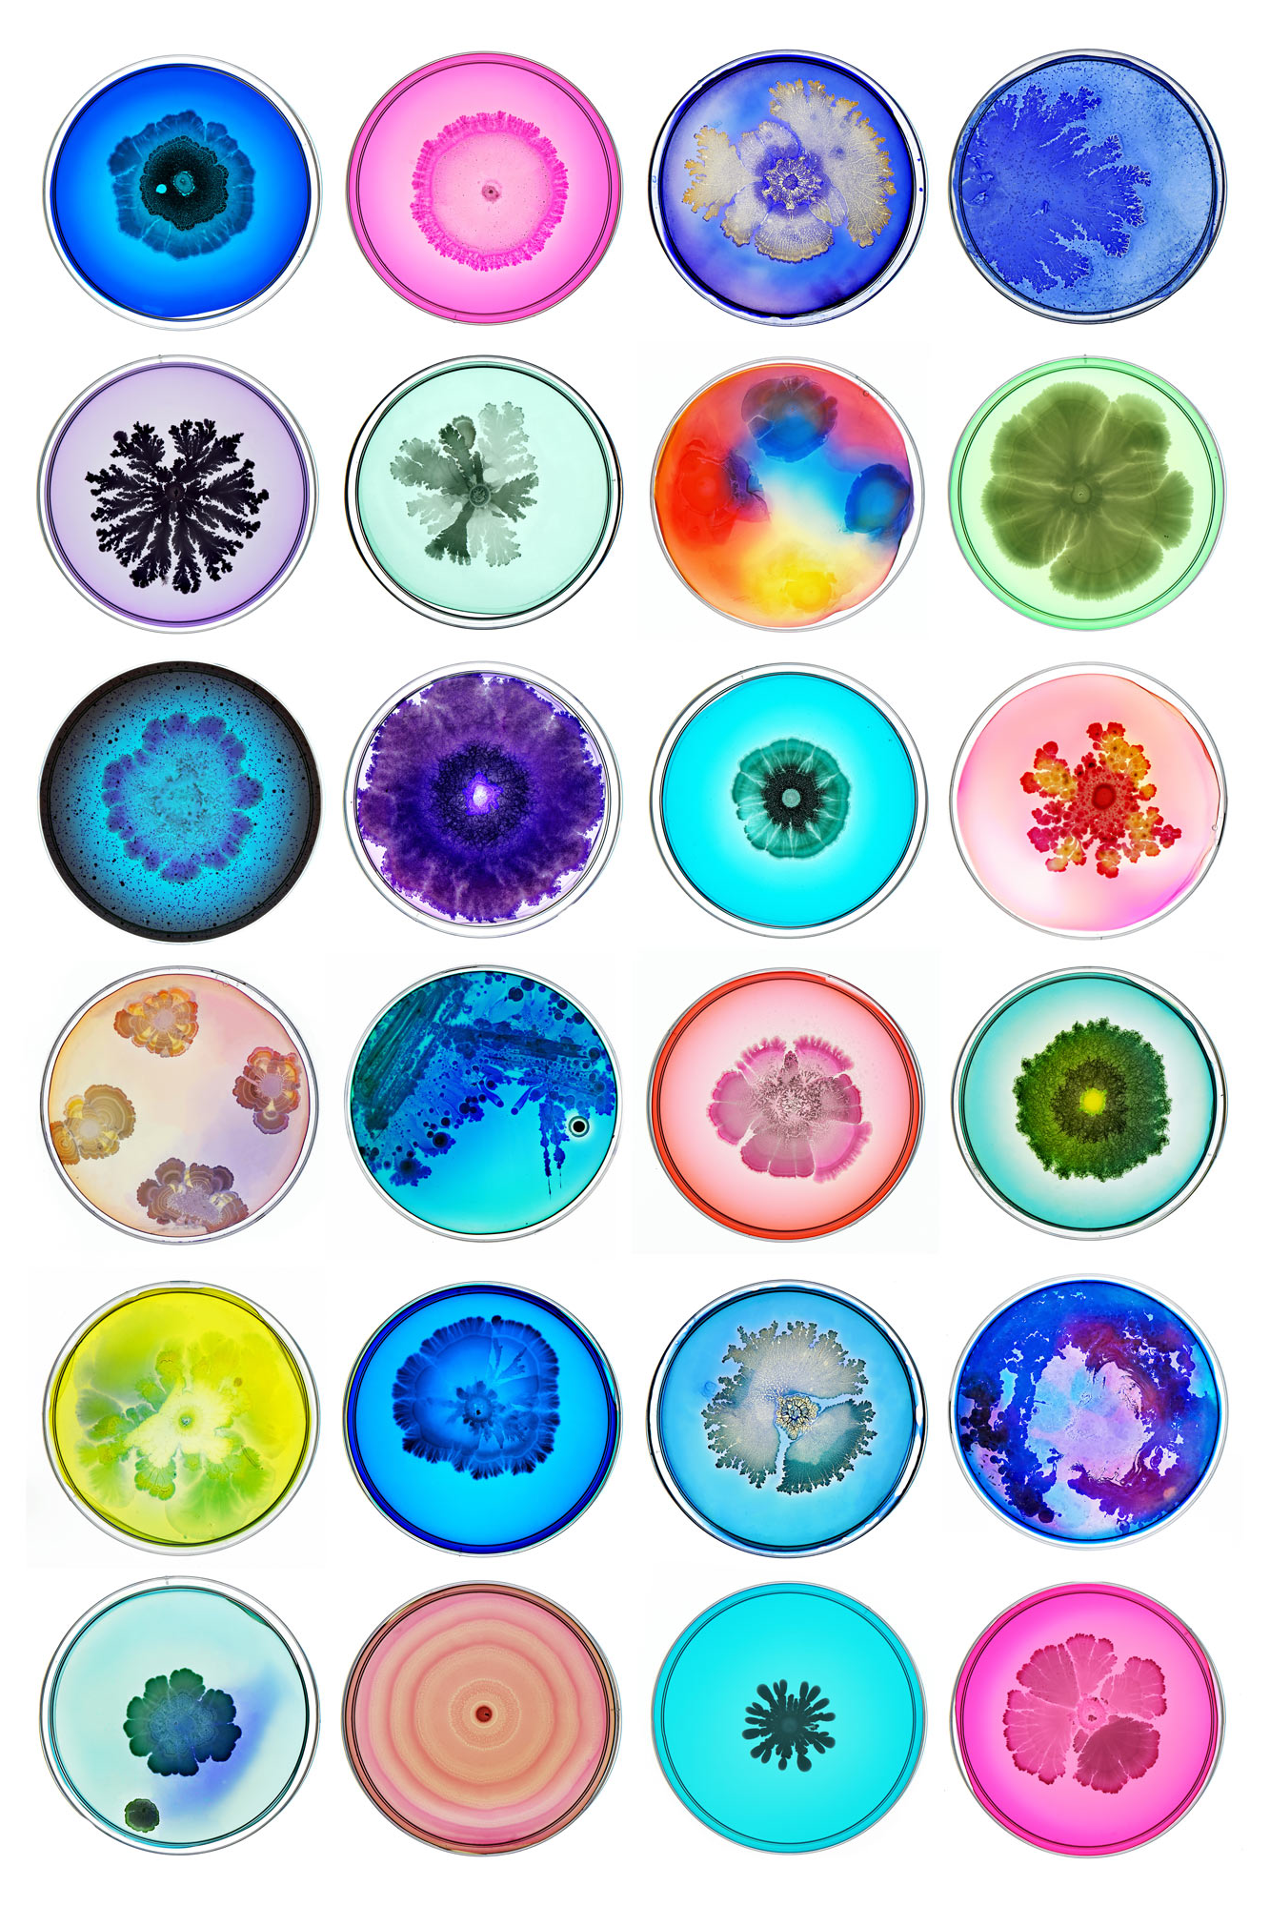
Bio212L Week #7: Biochemical assays
Spring 2025 | Section 2, Tu/Th 11:45am
Ava Mackay-Smith
Notes:
Image source: https://ideas.ted.com/gallery-the-most-beautiful-bacteria-youll-ever-see/

Slide 3
What are we getting up to today?
11:45: Today’s intro: Lab audits and Tuesday biochemical assays!
12:05: Set up Tuesday biochemical assays
12:35: Record Thursday biochemical assays
1:05: Environmental unknowns
Record keeping
Tests to do
Subculturing
Notes:
Stains stain!

Slide 4
Lab audits: general trends
How can I record results if I wasn’t present or I didn’t have time to finish the lab or I was told to move on?
I recorded my results. Why did I not get points on the “interpretation” part of the rubric?
My data was in my notebook in a comment/note to myself/different part of the notebook.
Another team member did an assay that I don’t have records of.

Slide 5
Lab audits: regrades & the next audit
Use your team!
Caveat: Remember for the lab practical you will still need to understand all of the tests/data we produce and how it works
Document incomplete results with an explanation & why you couldn’t get to something, or why something failed (especially with photos!)
Remember we have two more of these & this first one was you still working out what works for you for record keeping
This will all be curved!

Slide 6
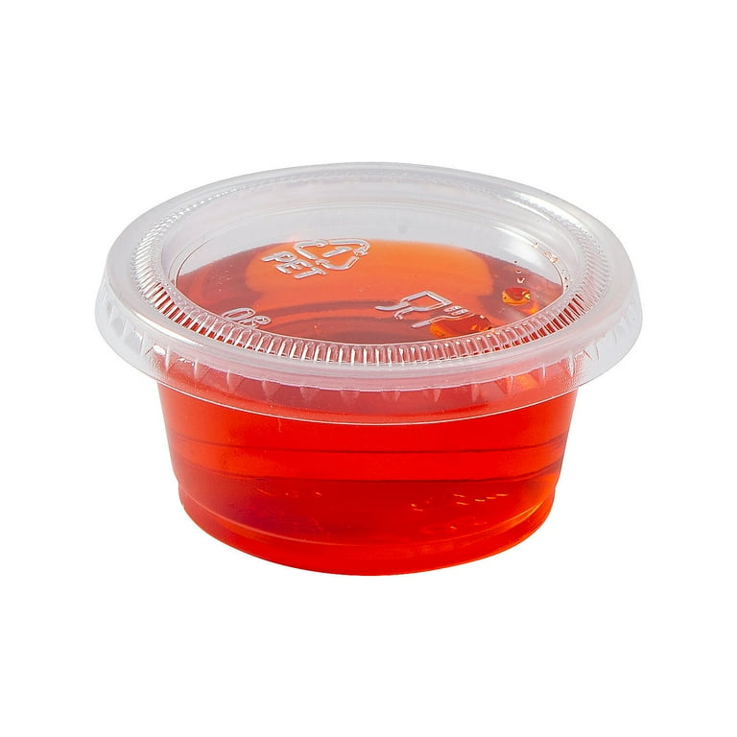
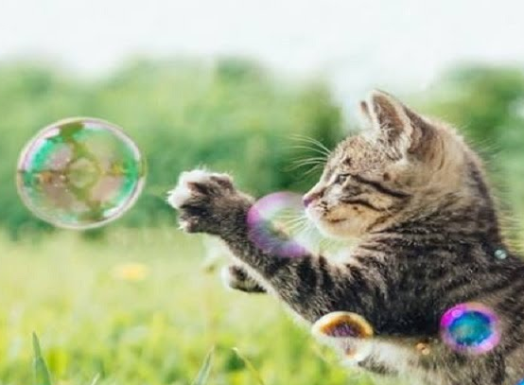



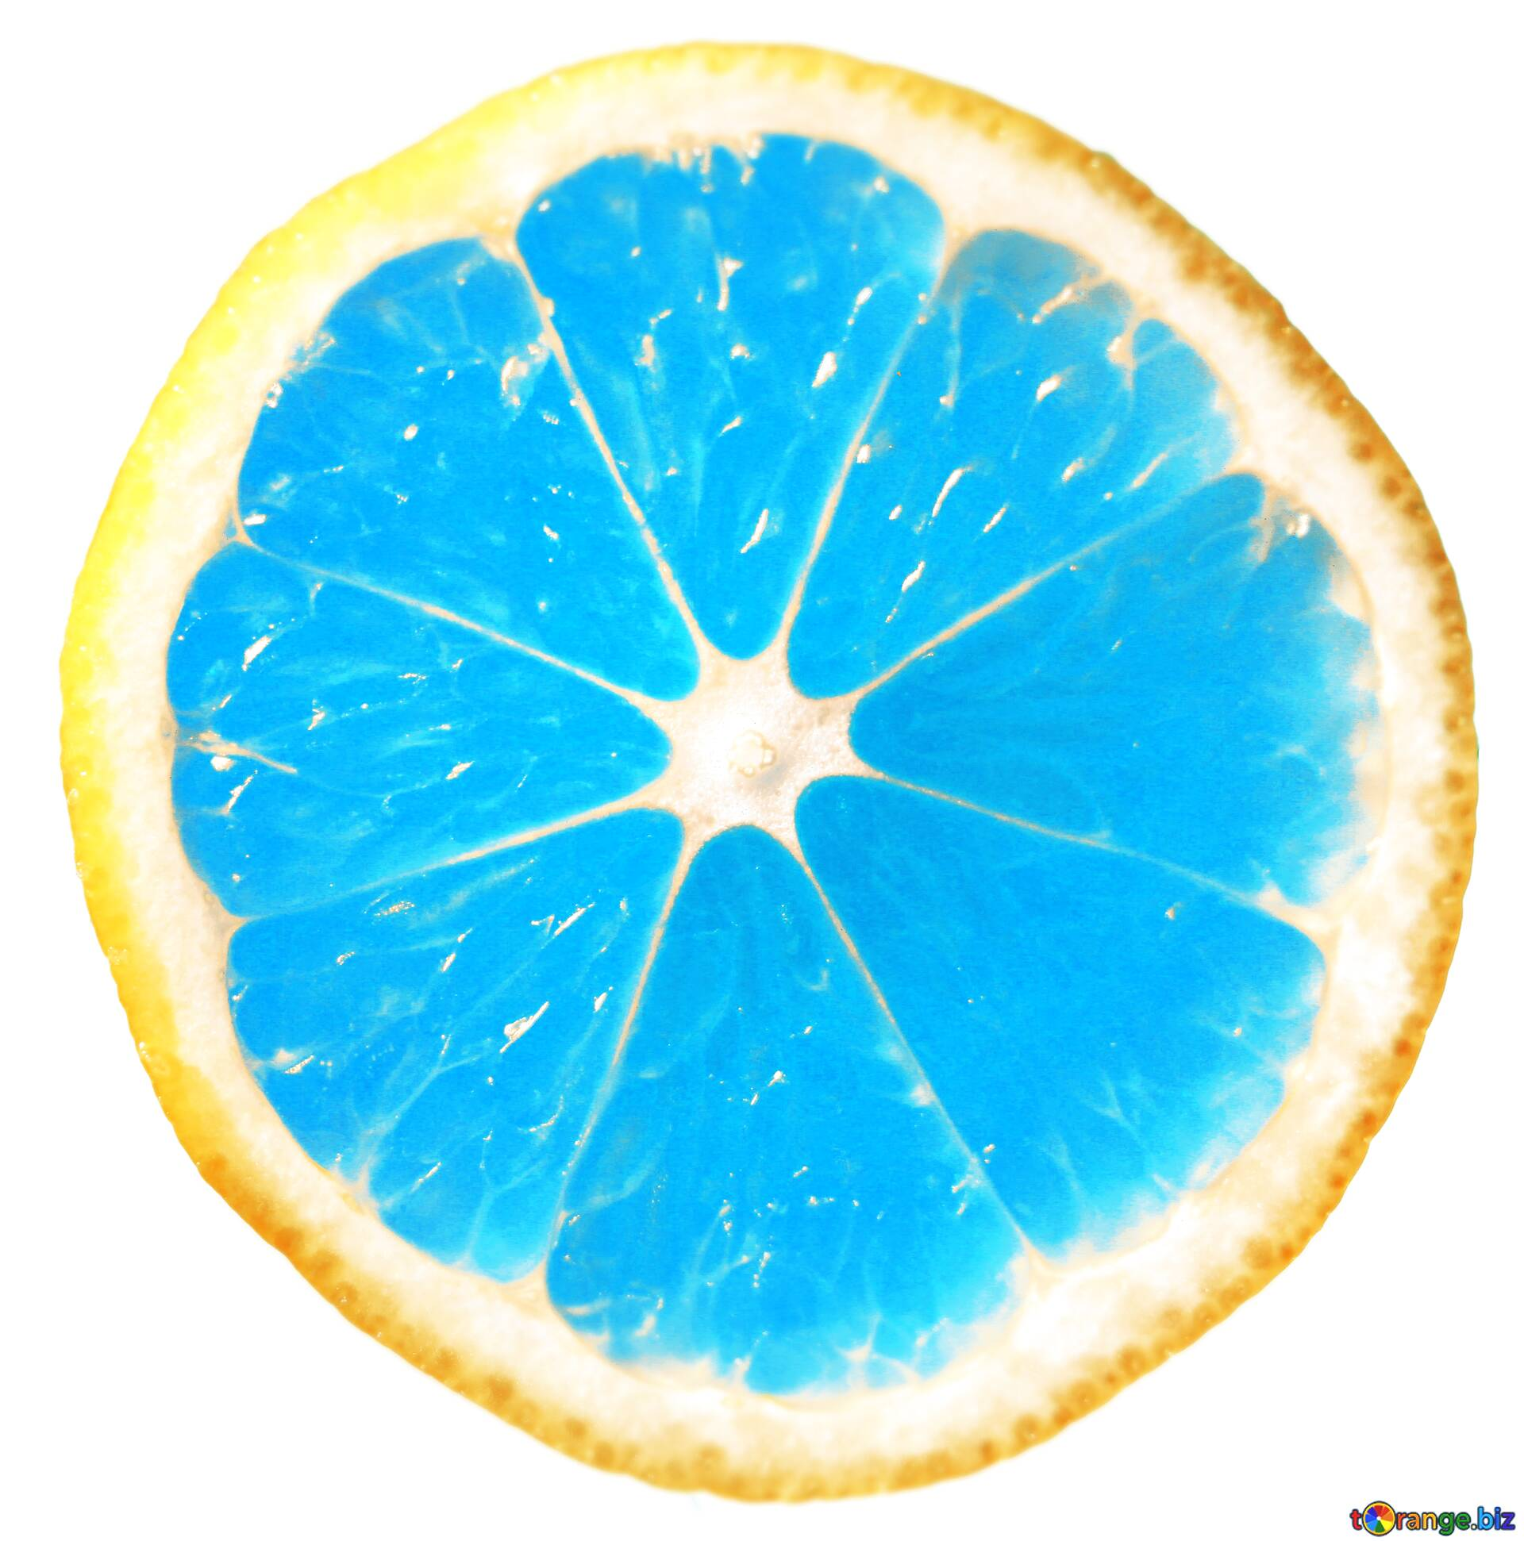

Thurs recap!
Gelatinase test
Positive readout: solid gelatin turns liquid
Catalase test
Positive readout: bubbles
Methyl Red test
Positive readout: yellow stoplight turns red
Oxidase test
Positive readout: blue
Urease (u’re ACE) test
Positive readout: yellow turns pink for valentine’s <3
Citrate utilization test
Positive readout: green turns to blue
Nitrate (night) reductase test
Positive readout: red or pale yellow (like the moon at night)
Notes:
How many of you found this to be the most confusing?
Apparently nobody called me on the citrate utilization
You need to know the name of the assay, high-level details for how to set it up/how it works, and how to read the test
Focus on learning how to read these assays!
We’re told to suggest making notecards for this

Slide 7

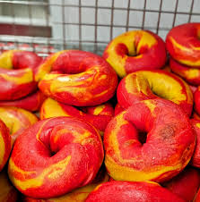
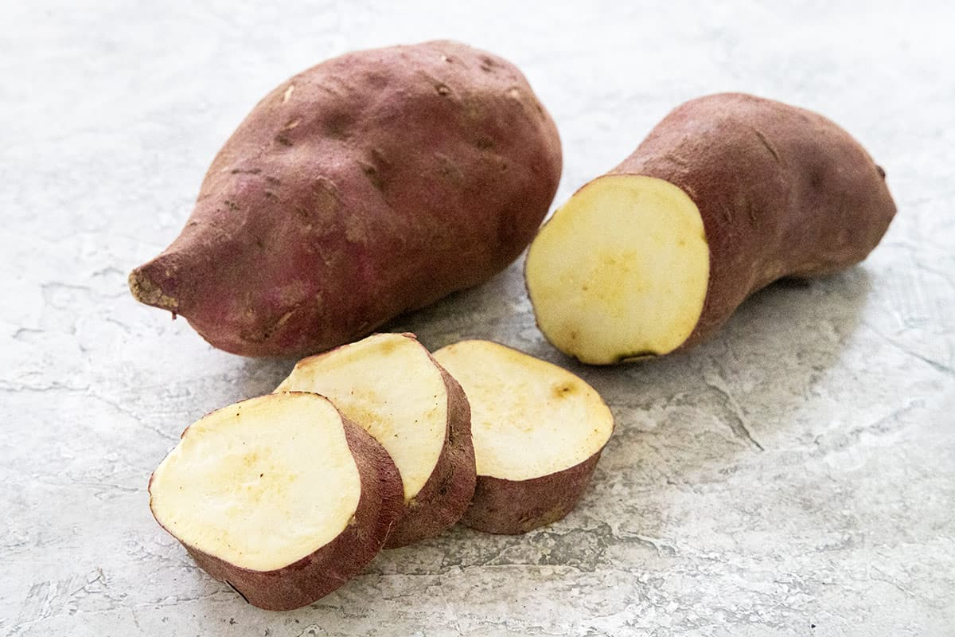
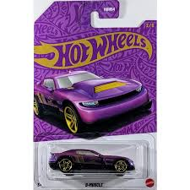


Today’s assays
Indole test
Positive readout: red (tests for a byproduct of tryptophanase – will tryp you up)
Acid from carbohydrates
Positive readout: Red to yellow
Starch hydrolysis test
Positive readout: dark brown turns pale
Decarboxylase test
Positive readout: yellow turns purple
Phenylalanine deaminase test
Positive readout: yellow turns green for St. Patrick’s day
Voges-Proskauer (VP) test
Positive readout: red
Notes:
You need to know the name of the assay, high-level details for how to set it up/how it works, and how to read the test
Focus on learning how to read these assays!
We’re told to suggest making notecards for this

Slide 8
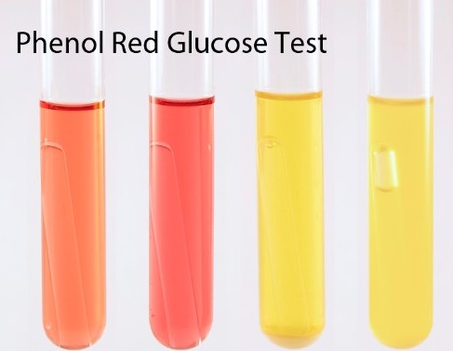
Acids from carbohydrates
Any given bacteria:
may be able to use a variety of different carbohydrates as carbon sources.
(e.g., simple sugars, sugar alcohols, complex carbohydrates)
end products are acids that cause pH indicator to turn yellow
Notes:
Using just 23 of the most common carbohydrates, there are 8,388,608 different possible utilization patterns.
This can also be referred to as ‘carbohydrate fermentation’. On an exam this will be referred to as “acid from X” or “fermentation of x”
Phenol red (opposite of methyl red) turns yellow when acidic from carbohydrate use

Slide 9
Acids from carbohydrates
Any given bacteria:
Gas might be produced when sugar is converted to acids
A Durham tube allows gas detection
Durham tube added to the PR glucose test
Notes:
Using just 23 of the most common carbohydrates, there are 8,388,608 different possible utilization patterns.

Slide 10
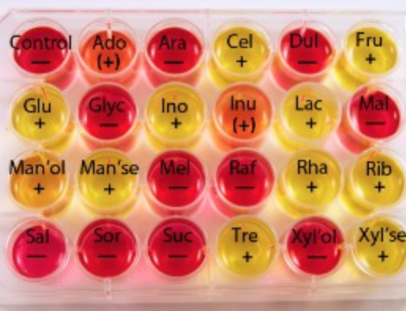
Acids from Carbs plate
Use one loop with big chunk just like salt tolerance plate
Notes:
Some species are very slow to metabolize carbohydrates. If all carbohydrates you test are negative, keep the them incubating up to 30 days to confirm the result.

Slide 11
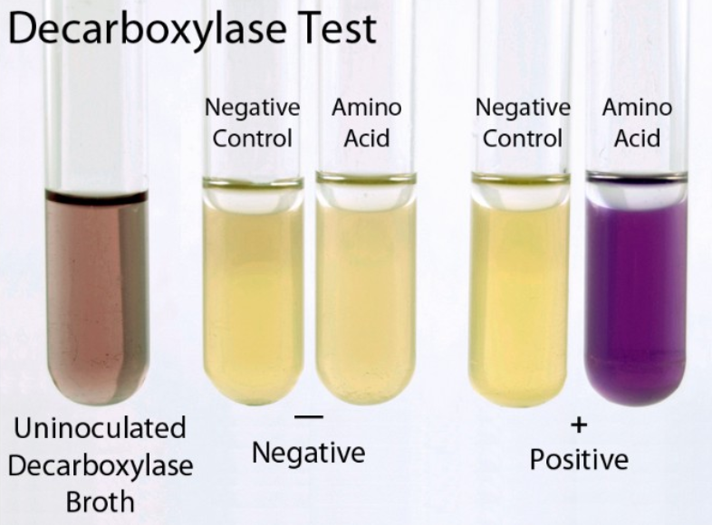
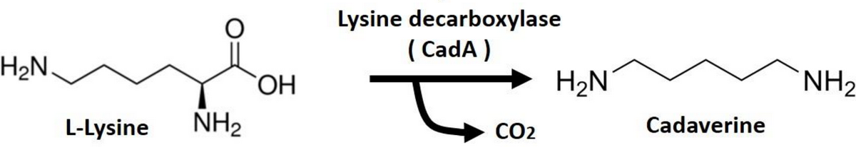
Decarboxylase test
+
+
Removes carboxyl group from amino acids
Remember to cover with mineral oil to create anoxic environment!
Amino acids: arginine, lysine or ornithine
Notes:
Decarboxylase enzymes play an important role in the metabolism of several amino acids. Decarboxylase reacts with the carboxyl group (COOH⁻) of an amino acid, forming CO₂ and an alkali product called an amine.
The media begins at a neutral pH and is purple.
Decarboxylase begins to work when enough bacteria grow and the pH is low.
The test must be run anaerobically so that the bacteria first ferment glucose in the media to produce lactic acid and bring the pH down (acidic) changing the media to yellow.

Slide 12
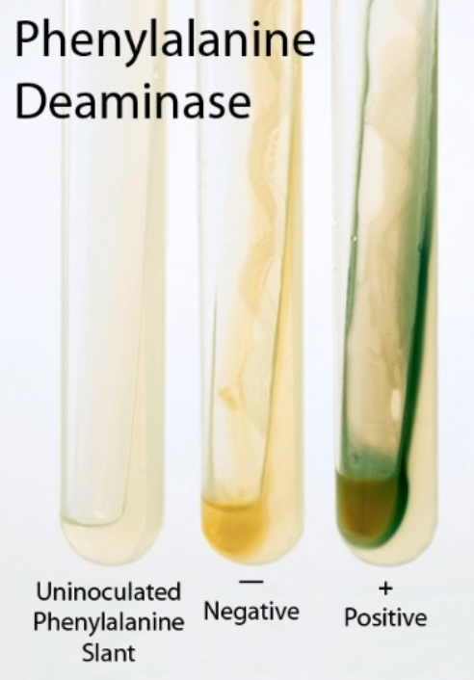
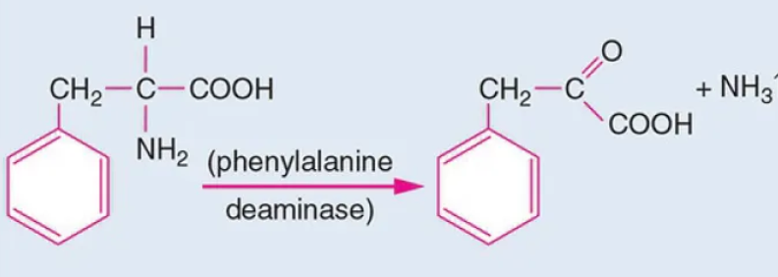
Phenylalanine Deaminase test
Removes amine group from amino acid Phe.
Notes:
This test is generally used to distinguish Proteus spp. and Providencia spp. from other common genera of the family Enterobacteriaceae.
This week: Heavily inoculate a phenylalanine slant and incubate at optimum growth temperature for 24 hours.
Next Week: Drip 10% ferric chloride (i.e., Iron(III) ammonium sulfate) down the surface of the slant to cover the bacterial growth and record within 5 minutes.

Slide 13
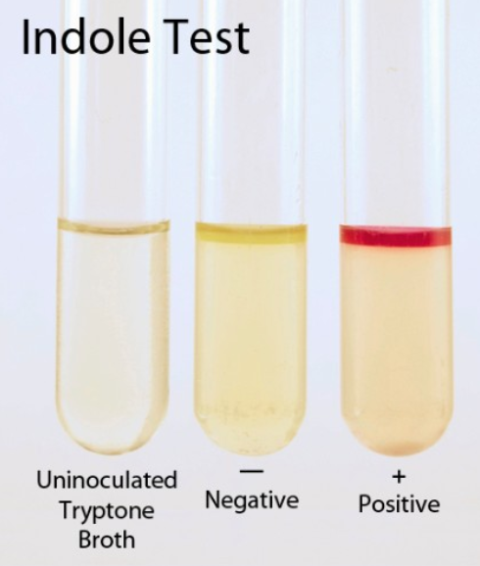
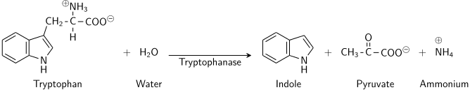
Indole Test
Tryptophanase converts tryptophan to indole.
We test for indole.
This week: Inoculate tryptone broth.
Next week: Add Kovac's reagent directly to the incubated broth, read test results immediately.
Notes:
Tryptophanase catalyzes the hydrolysis of the amino acid tryptophan with the production of indole, pyruvic acid, and water. We indirectly test for tryptophanase by assaying for the product indole. This test is important for differentiating genera in the family Enterobacteriaceae, especially Escherichia from Klebsiella. The indole test is also used to differentiate species in the genera Paenibacillus and Bacillus.

Slide 14
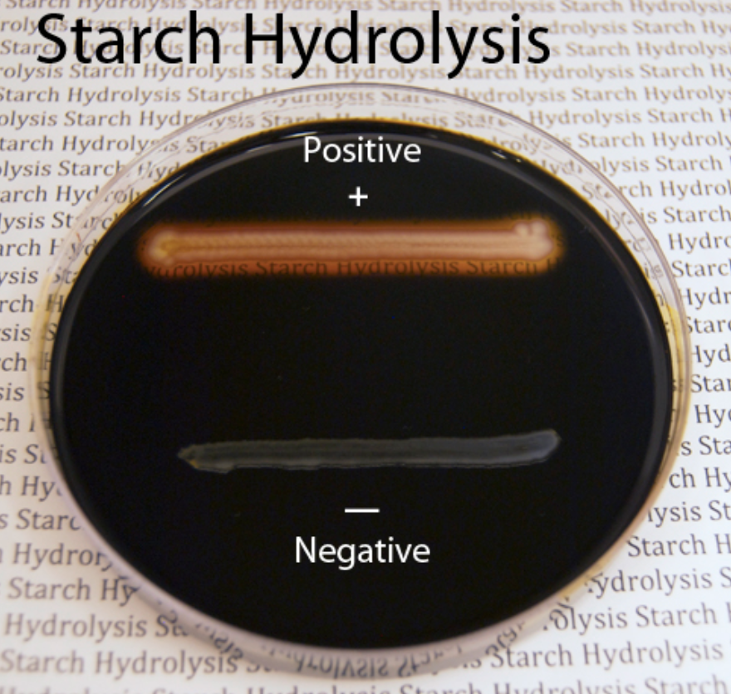
Starch Hydrolysis
Alpha-amylase
catalyzes the hydrolysis of starch into maltose
Notes:
Streak in a straight line

Slide 15
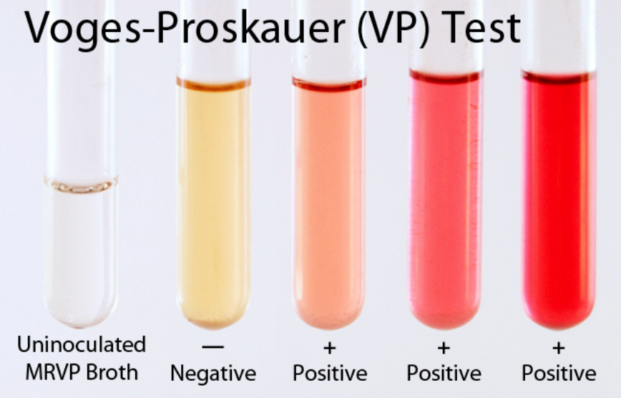
Voges-Proskauer (VP) Test
Identifies production of acetoin
most accurate after 24 hours of incubation
Use the future incubation basket!!!
Used in the differentiation of Enterobacteriaceae family members, Aeromonas spp., and Listeria spp.
Notes:
The VP test identifies bacterial species that produce acetoin, a neutral end product, from glucose fermentation. Acetoin is a precursor in the butanediol pathway which turns red in the presence of oxygen and KOH.
Acetoin is used up soon after it is produced, so the VP test is most accurate after 24 hours of incubation.

Slide 16
MR-VP test
Timing is wonky b/c they are usually done in a single tube to save time and resources
We are doing MR & VP separately
For your unknown, you can do VP first, then MR second
Saves media!

Slide 17
What are we getting up to today?
11:45: Today’s intro: Lab audits and Tuesday biochemical assays!
12:05: Set up Tuesday biochemical assays
12:35: Record Thursday biochemical assays
1:05: Environmental unknowns
Record keeping
Tests to do
Subculturing
Notes:
CLOCK 30min

Slide 18
Today’s assays
Indole test
Acid from carbohydrates
Inoculate only once
Starch hydrolysis test
Decarboxylase test
Inoculate in a straight line
Remember mineral oil!
Voges-Proskauer (VP) test
Phenylalanine deaminase test
Use the overnight basket!
Notes:
Quick vote: I’ll need to lecture two more times for how to record Thursday’s results and what we’re doing with unknowns. Keep going or check in after each activity? If I don’t get a strong vote then we’re going to check in, if you all hate that idea as a majority vote then lecture now & ask me when you want to see a slide again
CLOCK 30min
You need to know the name of the assay, high-level details for how to set it up/how it works, and how to read the test
Focus on learning how to read these assays!
We’re told to suggest making notecards for this

Slide 19
What are we getting up to today?
11:45: Today’s intro: Lab audits and Tuesday biochemical assays!
12:05: Set up Tuesday biochemical assays
12:35: Record Thursday biochemical assays
1:05: Environmental unknowns
Record keeping
Tests to do
Subculturing
Notes:
CLOCK 30min

Slide 20
Thurs recap!
Put samples AND control into 4C for 5 minutes
Gelatinase test
Positive readout: solid gelatin turns liquid
Results should already be recorded
Catalase test
Positive readout: bubbles
Demo!
Methyl Red test
Positive readout: yellow stoplight turns red
Results should already be recorded
Oxidase test
Positive readout: blue
Urease (u’re ACE) test
Positive readout: yellow turns pink for valentine’s <3
Citrate utilization test
Positive readout: green turns to blue
Demo!
Nitrate (night) reductase test
Positive readout: red or pale yellow (like the moon at night)
Notes:
CLOCK 30min
You need to know the name of the assay, high-level details for how to set it up/how it works, and how to read the test
Focus on learning how to read these assays!
We’re told to suggest making notecards for this

Slide 21
What are we getting up to today?
11:45: Today’s intro: Lab audits and Tuesday biochemical assays!
12:05: Set up Tuesday biochemical assays
12:35: Record Thursday biochemical assays
1:05: Environmental unknowns
Record keeping
Tests to do
Subculturing
Notes:
CLOCK 45min

Slide 22
Environmental Unknowns today: tasks
priority 1:
Subculture your strain
Streak one, store one, toss one
priority 2:
Make me a TA backup plate
(only if you haven’t already)
priority 3:
Collect catalase and oxidase info
or
Set up for doing that (overnight culture)
priority 4:
Start collecting “mandatory data” in the “Environmental Unknowns” page of LabArchives by using “Quick Protocols”

Slide 23
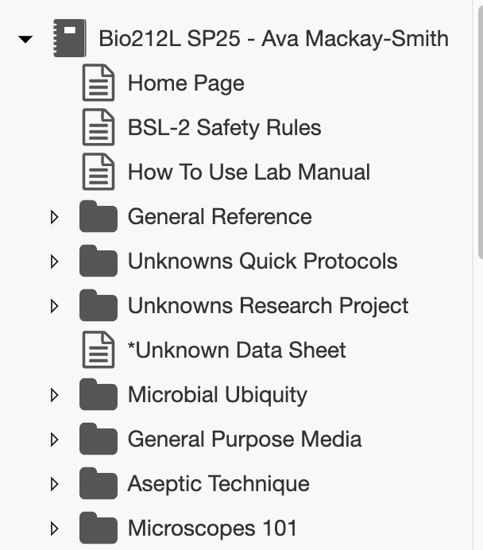
Environmental Unknowns: data collection
Good Tuesday assays:
temperature range
Acid from carbohydrates (3 & control, not 24-well)
Catalase and oxidase (but you should have this already)
Good anytime assays:
Oxygen tolerance – deeps & gas pak
Motility stabs
Endospores: talk to me if you have a gram-positive
When you are deciding which mandatory assays to start, think about the day of the week in terms of the total necessary incubation time of what you are starting
Notes:
Taught lab protocols are optimized for those specific microbes
Quick protocols are more general for unknowns
Taught lab protocols won’t always work for your unknowns, so use quick protocols

Slide 24
How to get out of lab on time
If you’re done with the lab’s protocols for the day:
1 – You and your group’s materials are all in the incubators where they need to be
2 – Wipe down your bench with 70% ethanol and turn off your incinerators
3 – Log out of LabArchives and wash or ethanol your hands
Still do your prelab quiz for Thurs even if we have a snow day!
Get those lab notebook audits in if you’re planning to submit (week 1 regrades give more credit than week 2!)

